Slide 1
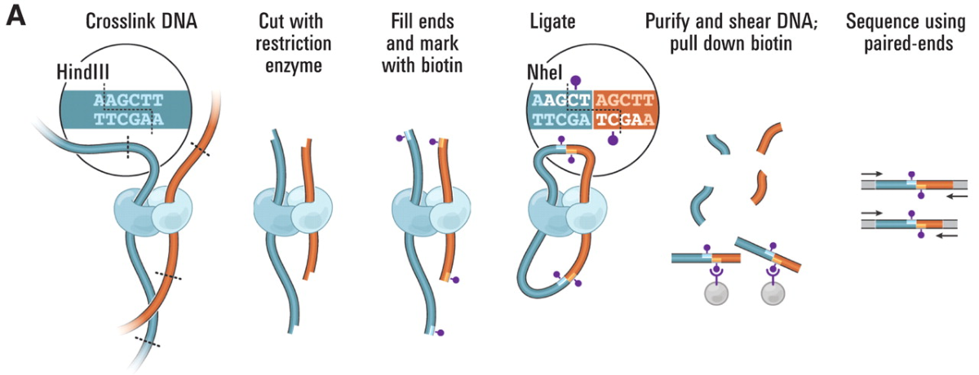
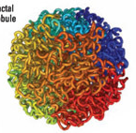
Types of sequencing reads
Proximity ligation or Hi-C libraries
Sequenced with paired-end Illumina
Formaldehyde
(creates covalent
bonds)
Images from: Van Berkum NL, Lieberman-Aiden E, Williams L, Imakaev M, Gnirke A, Mirny LA, Dekker J, Lander ES. Hi-C: a method to study the three-dimensional architecture of genomes. Journal of visualized experiments: JoVE. 2010(39).

Slide 2
Types of sequencing reads
Proximity ligation or Hi-C libraries
Sequenced with paired-end Illumina
Images from: Van Berkum NL, Lieberman-Aiden E, Williams L, Imakaev M, Gnirke A, Mirny LA, Dekker J, Lander ES. Hi-C: a method to study the three-dimensional architecture of genomes. Journal of visualized experiments: JoVE. 2010(39).

Slide 3
Types of sequencing reads
Proximity ligation or Hi-C libraries
Sequenced with paired-end Illumina
Images from: Van Berkum NL, Lieberman-Aiden E, Williams L, Imakaev M, Gnirke A, Mirny LA, Dekker J, Lander ES. Hi-C: a method to study the three-dimensional architecture of genomes. Journal of visualized experiments: JoVE. 2010(39).

Slide 4
Types of sequencing reads
Proximity ligation or Hi-C libraries
Sequenced with paired-end Illumina
Images from: Van Berkum NL, Lieberman-Aiden E, Williams L, Imakaev M, Gnirke A, Mirny LA, Dekker J, Lander ES. Hi-C: a method to study the three-dimensional architecture of genomes. Journal of visualized experiments: JoVE. 2010(39).

Slide 5
Types of sequencing reads
Proximity ligation or Hi-C libraries
Sequenced with paired-end Illumina
Images from: Van Berkum NL, Lieberman-Aiden E, Williams L, Imakaev M, Gnirke A, Mirny LA, Dekker J, Lander ES. Hi-C: a method to study the three-dimensional architecture of genomes. Journal of visualized experiments: JoVE. 2010(39).

Slide 6
Types of sequencing reads
Proximity ligation or Hi-C libraries (variants: Omni-C, Chicago)
Sequenced with paired-end Illumina
Images from: Van Berkum NL, Lieberman-Aiden E, Williams L, Imakaev M, Gnirke A, Mirny LA, Dekker J, Lander ES. Hi-C: a method to study the three-dimensional architecture of genomes. Journal of visualized experiments: JoVE. 2010(39).

Slide 7
What kind of data do you get?
Pairs or reads: random orientations, unknown distances

Slide 8
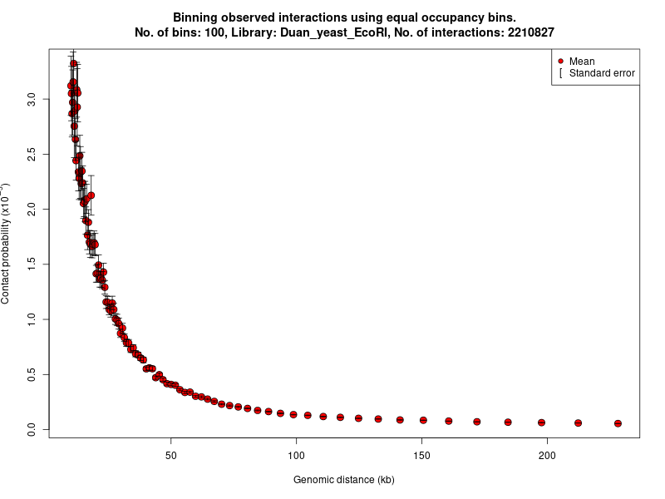
Hi-C scaffolding: why it works?
Contig 1
Contig 2
Many contacts (links) == nearby
Few contacts (links) == far away
Image from: https://www.bioconductor.org/packages/release/bioc/vignettes/FitHiC/inst/doc/fithic.html

Slide 9
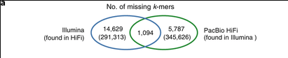
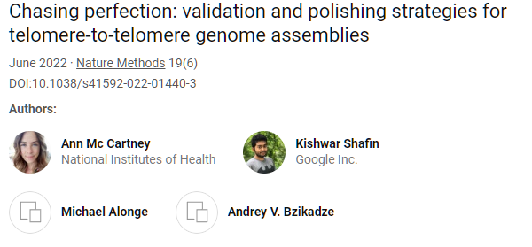
Sequencing: what could go wrong
PacBio vs Illumina
Human assembly vs K-mers in Illumina and PacBio HiFi reads

Slide 10
Repeat regions cause mistakes
A
R
B
R
C
A
R
C

Slide 11
Long reads help avoid mistakes
A
R
B
R
C

Slide 12
Choosing the right sequencing strategy
The right sequencing strategy depends on your budget and availability of sequencing services
The simplest strategy: get 30-40x genome coverage with PacBio HiFi reads
Alternative strategy: get 30-40x genome coverage with Oxford Nanopore reads + 30-50x coverage with Illumina reads
Perform hybrid assembly (correct ONT with Illumina first)
Assemble ONT reads and then correct assembly with Illumina
For chromosome-sized scaffolds you may need ONT Ultralongs or Hi-C reads

Slide 13
Assembly levels
Contigs are contiguous genome sequences where all letters are known
Scaffolds are ordered and oriented sets of contigs, gaps between contigs are of estimated size or set to a default value
Super-scaffolds or pseudo-chromosomes are ordered and mostly oriented sets of scaffolds, gaps between scaffolds are typically not estimated

Slide 14
Genome assembly strategies
Contig assembly uses reads:
Overlap Graph
String graph
K-mer (or DeBruijn) graph
Scaffolding/super-scaffolding uses
Long reads or
Oriented or unoriented pairs of reads

Slide 15
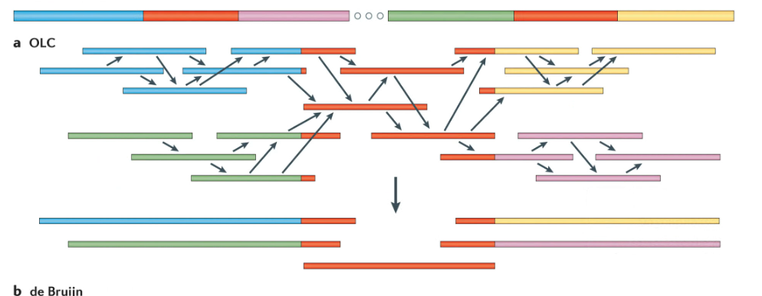
Overlap-Layout-Consensus
Overlap – compute overlaps between reads based on sequence alignments
Layout – assemble overlapping reads (greedy or string graph)
Consensus – generate contig sequences, by majority vote
Chaisson et al., (2015)

Slide 16
Overlap
An overlap is an alignment between a pair of reads
Can be Inverse
Or Forward

Slide 17
Recording an overlap
Choose the first read, it is always forward, it specifies the coordinate system
Record orientation
Record overhangs (A and B), read ends are coordinate starts
A-overhang(positive)
B-overhang (positive)
A-overhang(negative)
B-overhang (negative)
A-overhang(negative)
B-overhang (positive)
Contained overlap

Slide 18
Overlap is not an alignment
In there are indels, you can choose the longest stretch without them
Record R1, R2, orientation, A-hang, B-hang, overlap length or quality
AGATAGACATAGACATAGACAGATACAC ATAGACACAGACTATAGGCAGATACACTCGAT
AGATAGACATAGACATAGACAGATACAC ATAGACACAGACTATAGGCAGATACACTCGAT
R1(+): AGATAGACATAGACATAGACAGATACAC R2(-): ATAGACACAGACTATAGGCAGATACACTCGAT
Overlap:
R1 R2 – 1 5 27 or
R1 R2 – 2 5 26

